Slide 1
UNIVERSITI TUN HUSSEIN ONN MALAYSIA

Slide 2


Slide 3
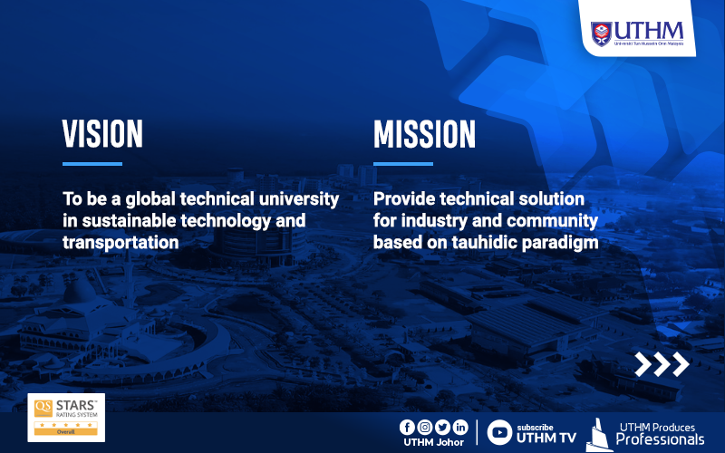

Slide 4
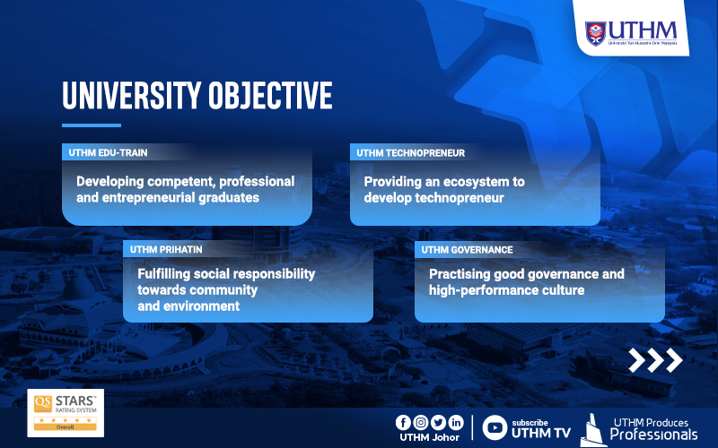

Slide 5
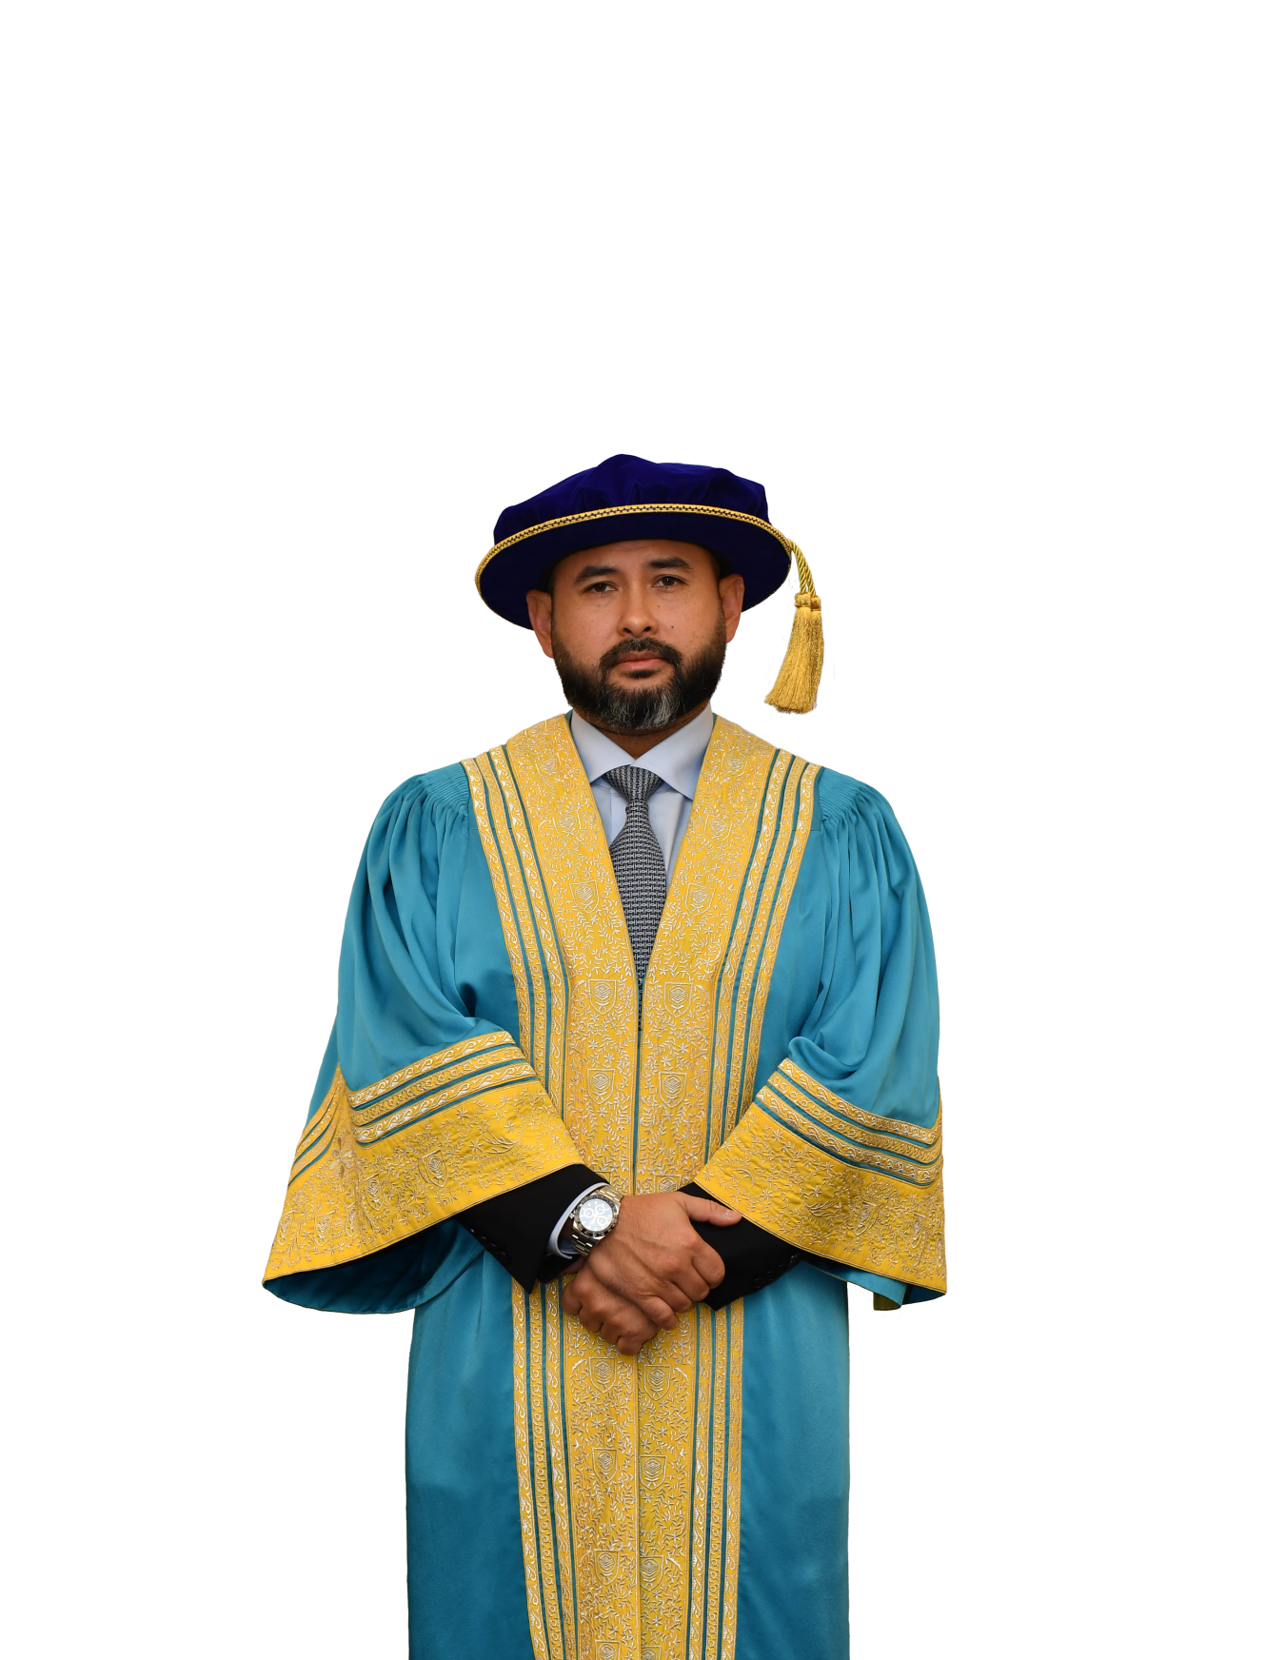
CHANCELLOR
HIS ROYAL HIGHNESS
TUNKU ISMAIL
IBNI SULTAN IBRAHIM
The Regent of Johor

Slide 6
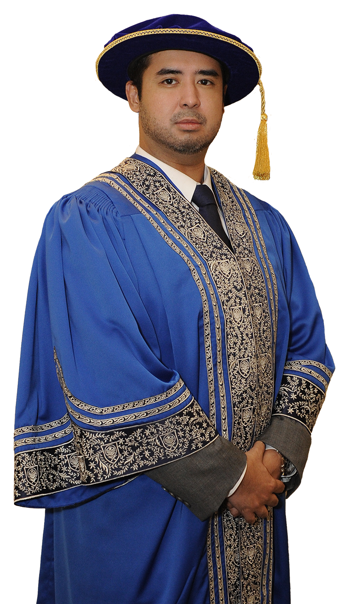
PRO-CHANCELLOR
HIS HIGHNESS
TUNKU IDRIS ISKANDAR
AL-HAJ IBNI SULTAN IBRAHIM
The Tunku Temenggong of Johor

Slide 7
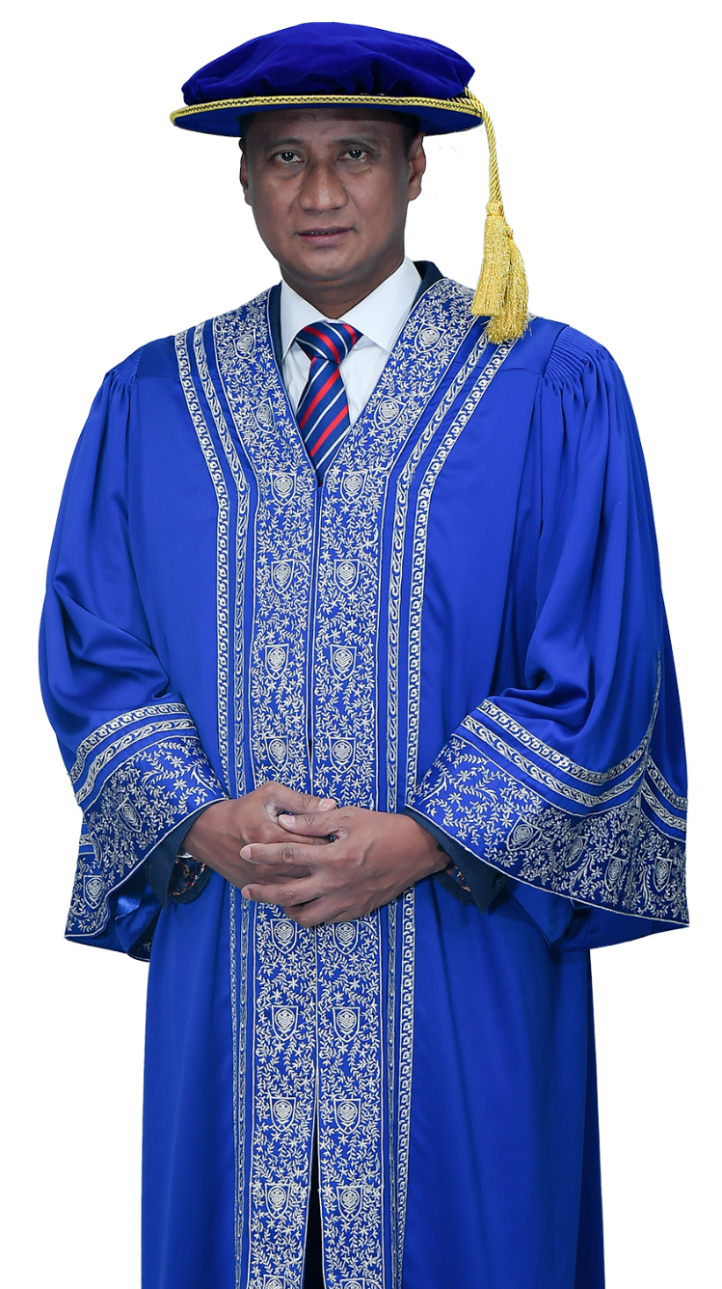
PRO-CHANCELLOR
YANG BERHORMAT
TAN SRI DATO’ Dr. HAJI AZMI
BIN ROHANI
State Secretary of Johor

Slide 8
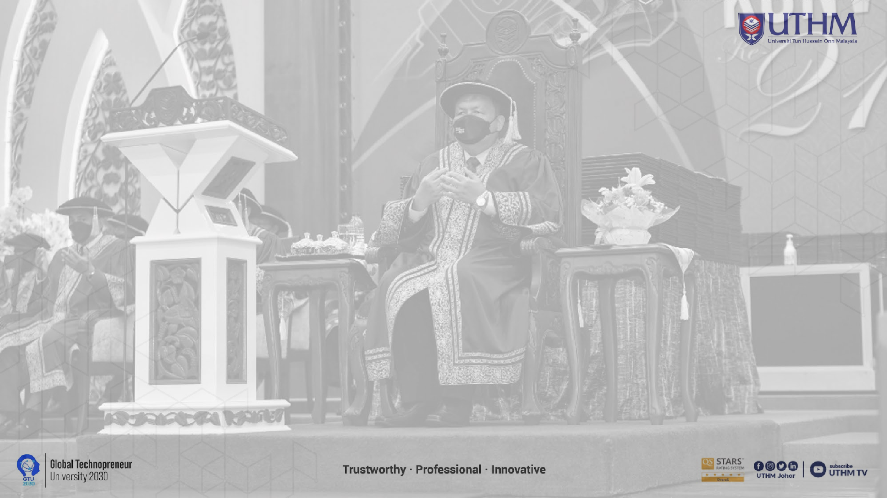
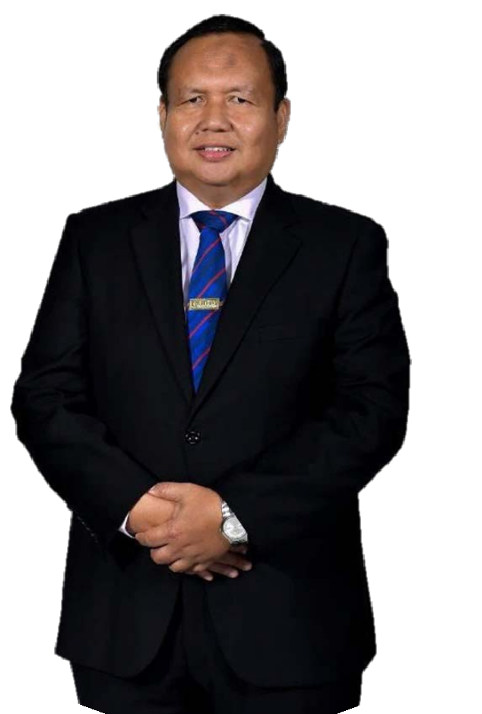
VICE CHANCELLOR
Prof. Dato’ Ir. Ts. Dr. Ruzairi bin Abdul Rahim

Slide 9
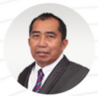

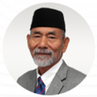
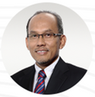
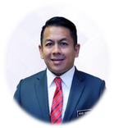
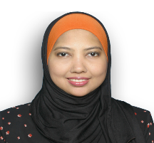
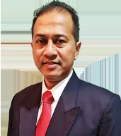
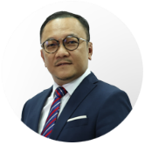

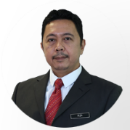
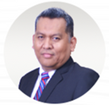
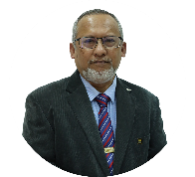
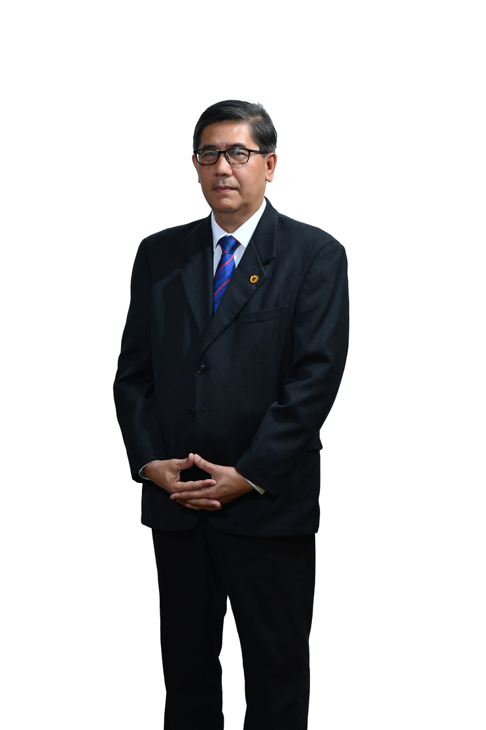
BOARD OF DIRECTORS
CHAIRMAN
YBhg. Dato' Sri Ibrahim bin Ahmad
MEMBERS
YB Prof. Dato’ Ir. Ts. Dr. Ruzairi bin Abdul Rahim
Vice-Chancellor
Universiti Tun Hussein Onn Malaysia
YB Dato' (Dr.) Haji Nooh bin Gadot
Advisor
Johor Islamic Religious Council
YBhg. Datuk Md Jais bin Haji Sarday
Board Member
Universiti Tun Hussein Onn Malaysia
YBhg. Dato' Dr. Mohd Sharil bin Abdullah
Director of Industrial Relations Division
Department of Higher Education, Ministry of Higher Education
YBrs. Puan Mahfuzah binti Baharin
Deputy Under-Secretary (Sector of Tax Incentive & Sectoral) TSBC(GCS)
Ministry of Finance
YBrs. Encik Hasry bin Harun
Chief Executive Officer
Malaysia Rail Development Corporation
YBhg. Datuk Haji Mohd Lassim bin Burhan
Board Member,
Universiti Tun Hussein Onn Malaysia
YBrs. Ir. Ts. Abdul Rahman Bahasa
Chief Executive Officer,
Recove Group
SECRETARY
YBrs. Mohamad Irza bin Dahari @ Zahari
Administration and Diplomatic Officer
Department Of Higher Education
Ministry of Higher Education
YBrs. Encik Shahril Anwar bin Mohd Yunos
Managing Partner,
Virtus Capital Partners
Sdn Bhd
YBhg. Prof. Ir. Dr. Mohd. Amri
bin Lajis
Professor
Universiti Tun Hussein Onn Malaysia
YBrs. Encik Naim bin Maslan
Registrar/Chief Operating Officer
Universiti Tun Hussein Onn Malaysia

Slide 10
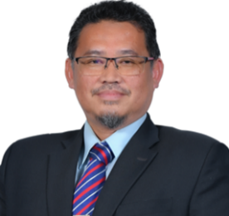
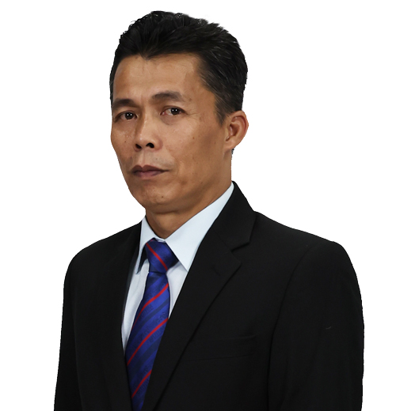
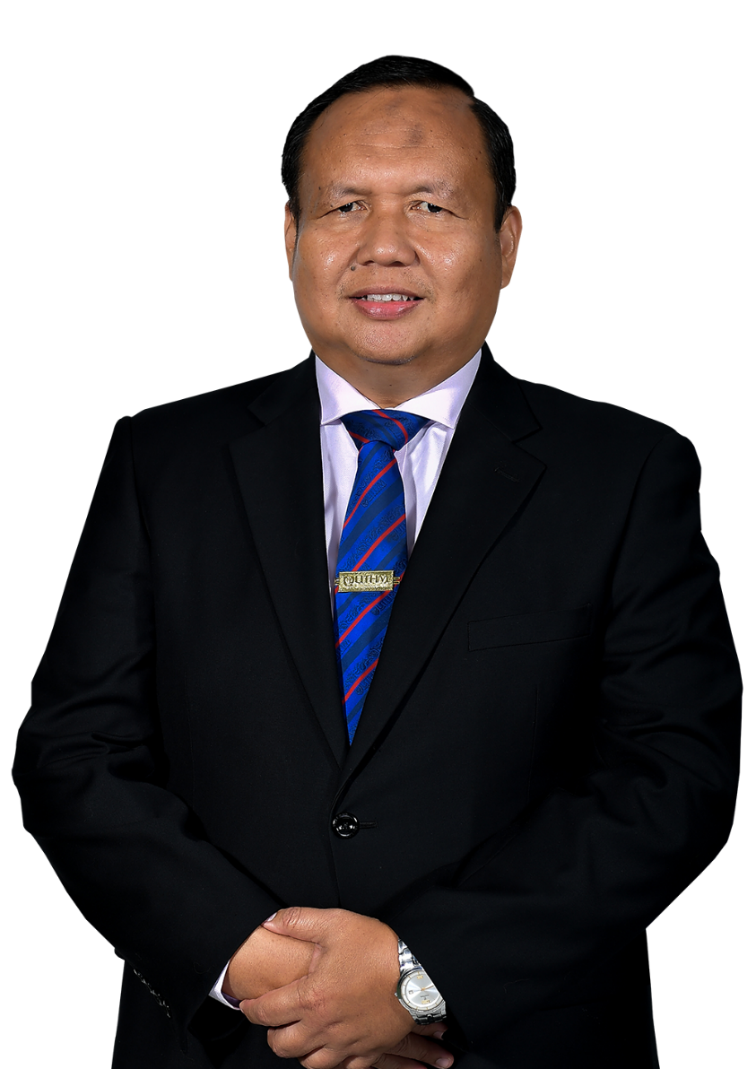
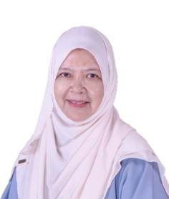
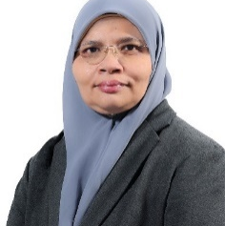
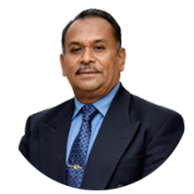
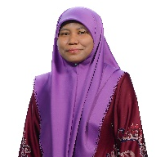
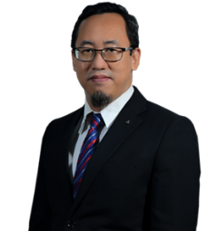
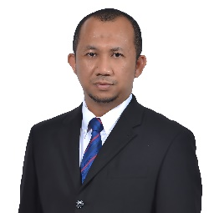
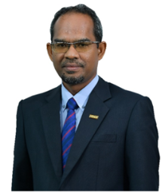
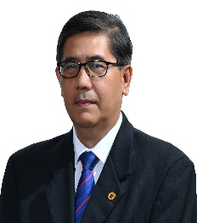
DEPUTY VICE CHANCELLOR (ACADEMIC & INTERNATIONAL)
UTHM EXECUTIVES
COMITTEE
BURSAR /
CHIEF FINANCIAL
OFFICER (CFO)
Encik Ismail bin Haron
Prof. Dr. Shahruddin bin Mahzan @ Mohd Zin
CHIEF LIBRARIAN
DEPUTY VICE CHANCELLOR (RESEARCH & INOVATION)
Puan Zaharah binti Abd Samad
Prof. Ts. Dr. Rabiah binti Ahmad
LEGAL ADVISOR
DEPUTY VICE CHANCELLOR
(STUDENT AFFAIRS & ALUMNI)
Puan Norliah binti Yaakub
Prof. Ts. Dr. Abdul Rasid bin Abdul Razzaq
ASSISTANT VICE CHANCELLOR (STRATEGIC & QUALITY)
VICE CHANCELLOR
PROVOST UTHM PAGOH BRANCH CAMPUS
YB Prof. Dato’ Ir. Ts. Dr. Ruzairi bin Abdul Rahim
Prof. Dr. Mas Fawzi bin Mohd Ali
Associate Prof. Dr. Afandi bin Ahmad
REGISTRAR/ CHIEF OPERATING OFFICER (COO)
ASSISTANT VICE CHANCELLOR (DIGITALIZATION & INFRASTRUCTURE)
Encik Naim bin Maslan
bin Abdul Rahman
Prof. Ir. Dr. Md Saidin bin Wahab

Slide 11
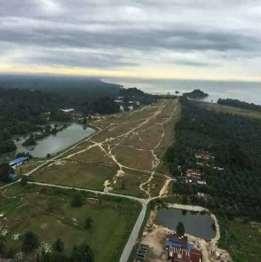
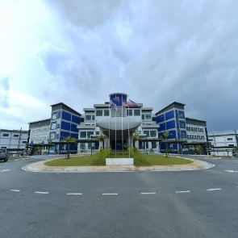
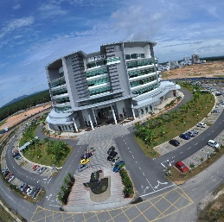
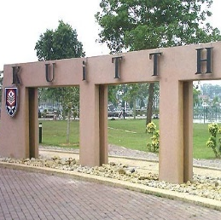
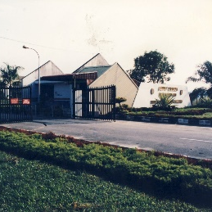
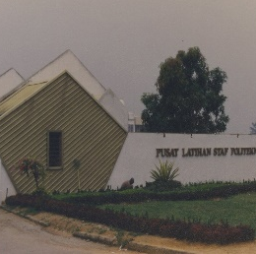
2017
UTHM
UTHM PAGOH
PAGOH
BRANCH CAMPUS
OPENING
MILESTONE
2020
2000
TANJUNG LABUH
KUiTTHO
TANJUNG LABUH
BRANCH CAMPUS
LAUNCHING
KOLEJ UNIVERSITI TEKNOLOGI TUN HUSSEIN ONN
2007
UTHM
Universiti Tun Hussein Onn Malaysia (UTHM), is one of the public universities in Malaysia primarily focusing on Engineering and Technology.
Niche Areas: Sustainable Technology and Transportation
UNIVERSITI TUN HUSSEIN ONN MALAYSIA
1996
ITTHO
INSTITUT TEKNOLOGI TUN HUSSEIN ONN

Slide 12




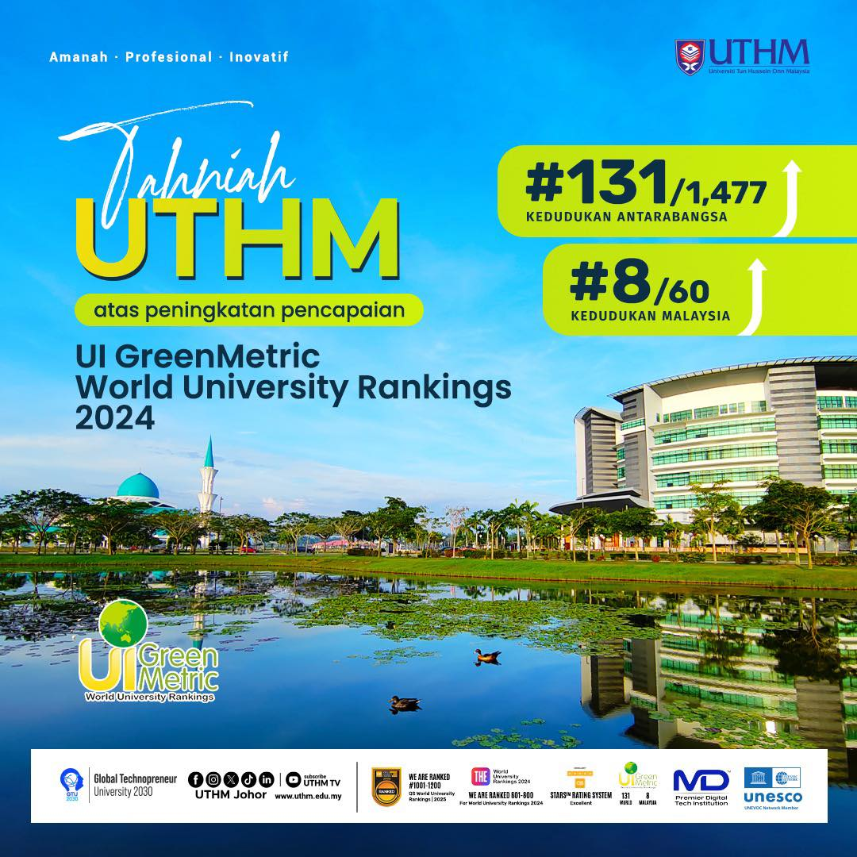
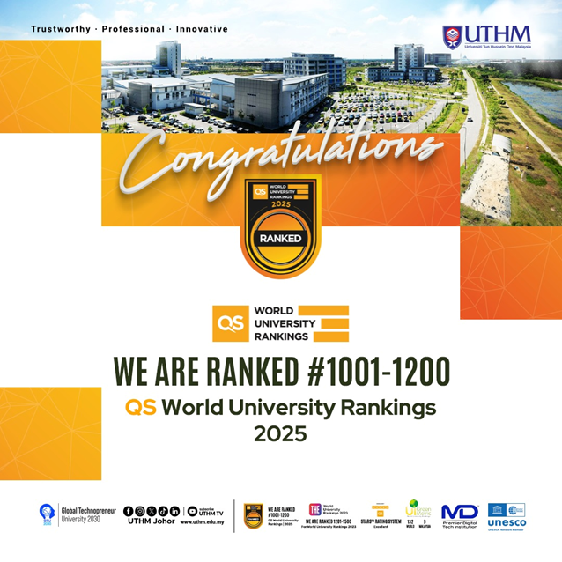


UTHM RANKING ACHIEVEMENT

Slide 13





UTHM ACHIEVEMENT

Slide 14
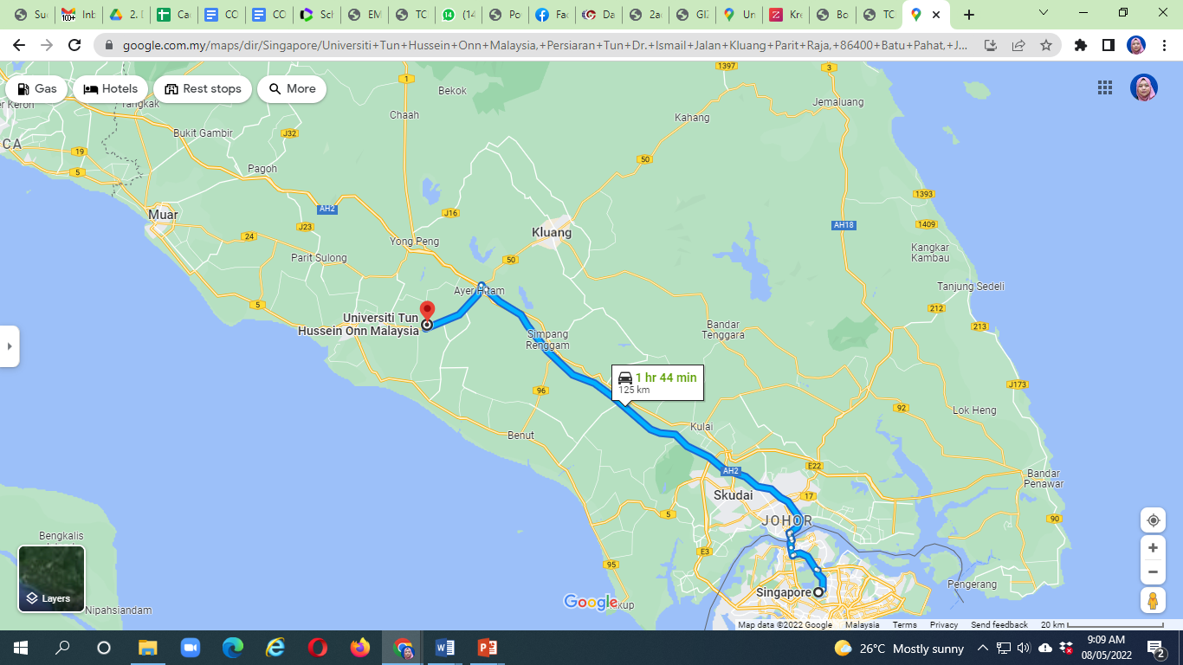

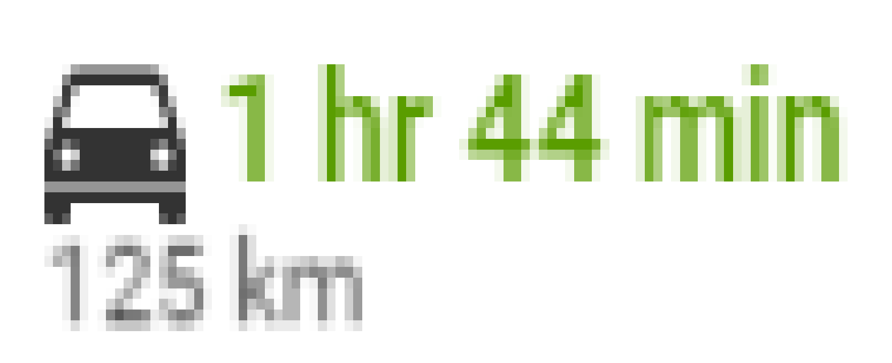
UTHM PAGOH
We are here
STRATEGICALLY LOCATED IN SOUTHERN PART OF MALAYSIA
15 km from North-South Expressway entrance/exit
240 km from KLIA (2½ hours)
100 km from Johor Bahru (1¼ hours)
85 km from Senai International Airport
125 from Singapore
264 km from Indonesia
SINGAPORE

Slide 15
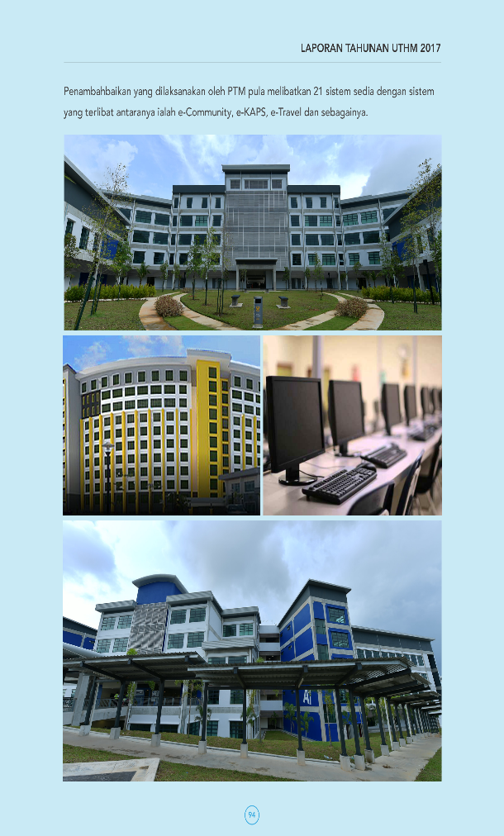

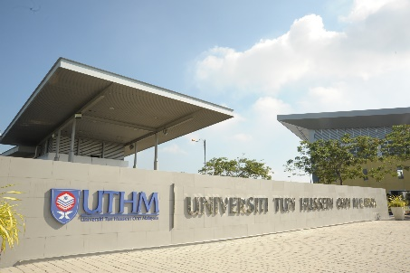
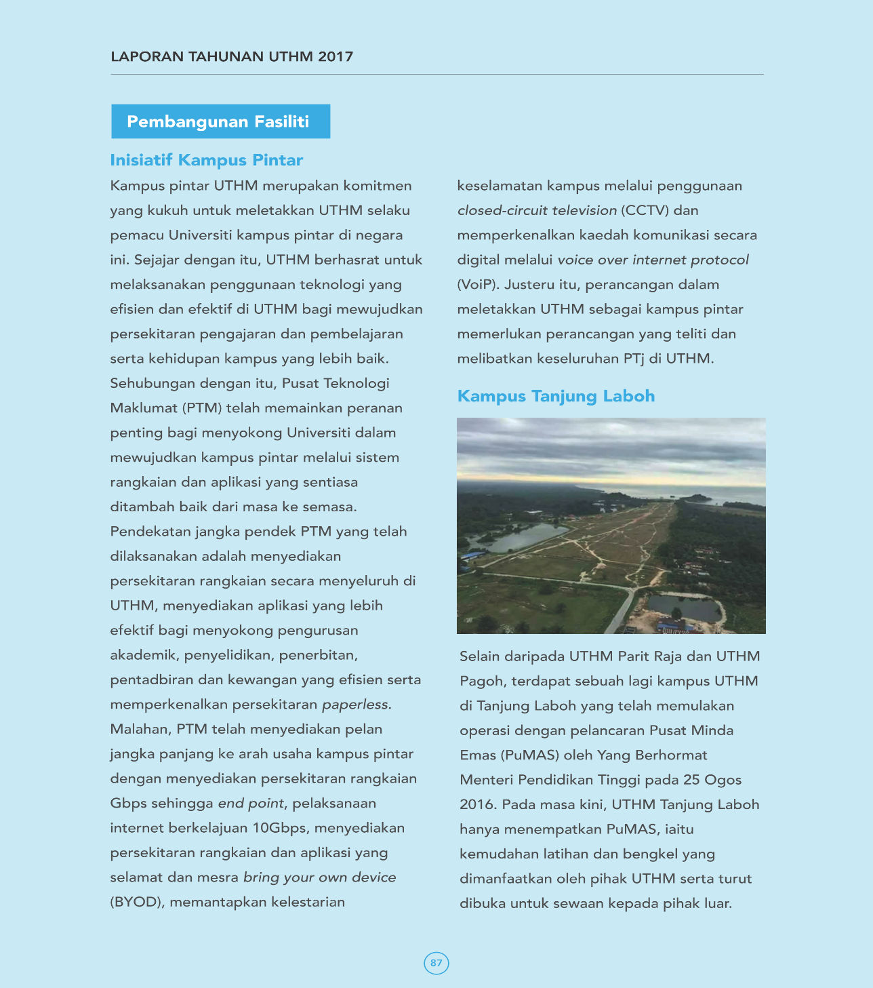
CAMPUSES
Negeri sembilan
Development = 65.97 acres
Future Use = 104.09 acres
Total = 170.87 acres
Pahang
Malacca
Pagoh Branch Campus
Muar
Batu Pahat
Main Campus
Tg Laboh Branch Campus
Singapore
Development = 376.35 acres
Future Use = 180.37 acres
Total = 556.72 acres
Development = 14.5 acres
Future Use = 312.84 acres
Total = 327.34 acres

Slide 16




MALAYSIA TECHNICAL
UNIVERSITY NETWORK
1
2
Sustainable Technology & Transportation
Advanced Manufacturing
and Computing Technology
NICHE
AREAS
4
3
Advanced Process Engineering and Automotive
Electronic and Automation Engineering

Slide 17
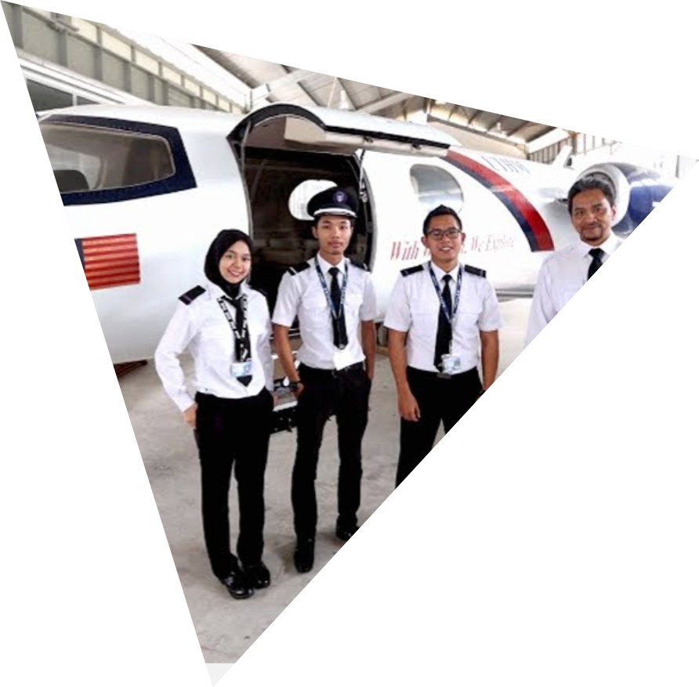
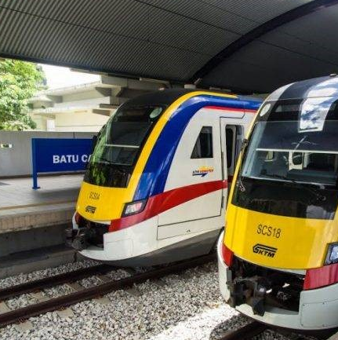
ACADEMIC
8
FACULTIES
Mechanical And Manufacturing Engineering
Civil Engineering And Built Environment
Electrical And Electronic Engineering
Technology Management And Business
Technical And Vocational Education
Computer Science And Information Technology
Applied Sciences And Technology
Engineering Technology
4
CENTRE OF
STUDIES
Centre for Graduate Studies
Centre for Diploma Studies
Centre for General Studies and Co-curricular
Centre for Language Studies
7
56
TVET Programmes
Diploma
105
52
4
Engineering Programmes
Bachelor Degree
PROGRAMMES
33
Master Degree
1
Non- Engineering Programmes
13
46
Doctor of Philosophy
Postgraduates Programmes

Slide 18








FACT & FIGURE: STUDENTS
36
1110
768
342
Countries
International students
Postgraduates
Undergraduates
number of international students
18,660
≈ 94% of total university’s student population are local.
Indonesia
194
students
UAE
189 students
Diploma
Bachelor Degree
Master
Doctorate
Yemen
119 students
2,218
13,720
1,416
1,296
China
92
students
Somalia
86
students
Data updated on 15.1.2025
Data updated on 08.01.25

Slide 19
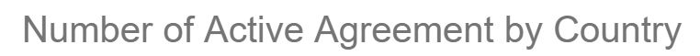
INTERNATIONAL RELATIONS
05
JD
Active International
Agreements
LoI
268
530
MoA
64
MoU
193
Data updated on 4.8. 2024

Slide 20











UTHM RESEARCH
5 Institutes for Research and Consultation
6 Center of Excellence (CoE)
27 Center of Research (CoR)
119 Focus Group
(FG)
Malaysia Research Institute for Vocational Education & Training (MyRIVET)
Institute for Integrated Engineering (I²E)
Institut Transformasi Sosial dan Pembangunan Wilayah (TRANSFORM)
Institut Ahli Sunnah Wal Jamaah (ISWAJ)
Malaysias Real Estate Institute (MyREI)
FKEE | 2
FKMP | 5
FAST | 3
FKAAB | 4
FTK | 3
FPTV | 2
FSKTM | 3
FPTP | 4
PPB | 1
FKEE | 18
FKMP | 15
FAST | 9
FKAAB | 12
FTK | 13
FPTV | 12
PPUK | 4
PPD | 15
FSKTM | 8
FPTP | 8
PPB | 5

Slide 21
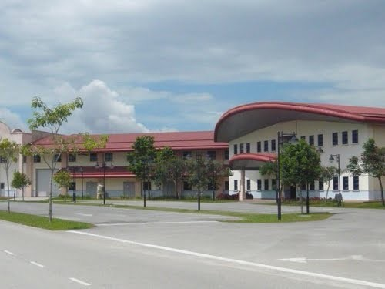
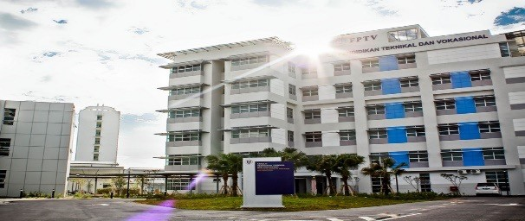
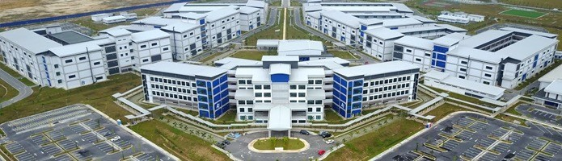
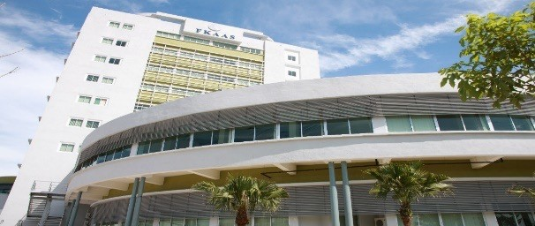
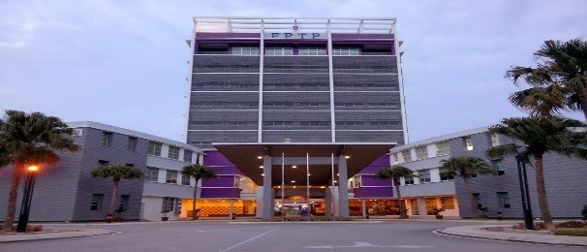




FACILITIES
Faculties
Faculty of Mechanical & Manufacturing Engineering
Faculty of Technical & Vocational Education
Faculty of Engineering Technology
Faculty of Technology Management & Business
Faculty of Applied Sciences & Technology
Faculty of Civil Engineering & Built Environment
Faculty of Electrical & Electronic Engineering
Faculty of Computer Science & Information Technology
Centre for Diploma Studies

Slide 22



FACILITIES
Recreation
Olympic-size Swimming Pool
Hockey Stadium, Football Stadium & Athletics Track
Sports Complex

Slide 23



FACILITIES
Tunku Tun Aminah Library

Slide 24



FACILITIES
Sultan Ibrahim Hall
(Convocation Hall)

Slide 25



FACILITIES
Sultan Ibrahim Mosque

Slide 26




FACILITIES
Residential Colleges

Slide 27





FACILITIES
Exam Halls
Student Centre & Banks
University Health Centre
Lecture Theatres
Graduate Square

Slide 28


Thank you!
“With Wisdom We Explore”
International Office Website
International Office
Universiti Tun Hussein Onn Malaysia
86400, Parit Raja,
Johor Darul Takzim,
Malaysia.
Email: io@uthm.edu.my
Email Director: director.io@uthm.edu.my

Slide 29


Terima Kasih
Thank You

